Slide 1
Docker

Slide 2
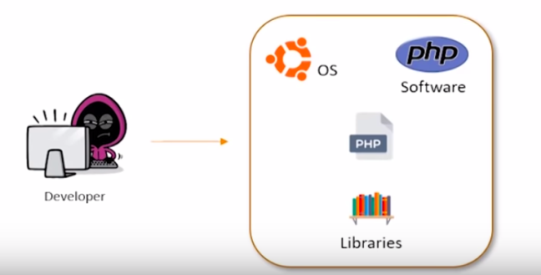
Web application development

Slide 3
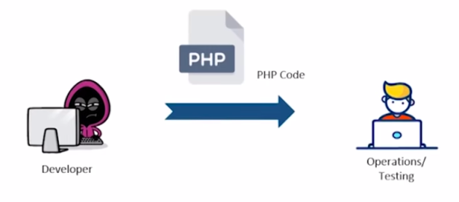
Web application Deployment

Slide 4
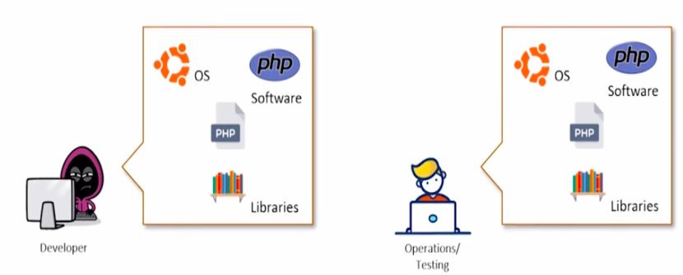
Web application Deployment

Slide 5
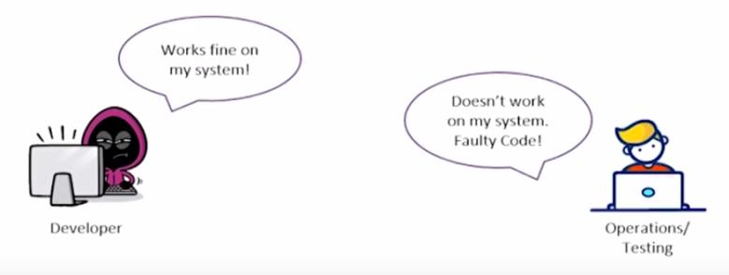
Problem ?

Slide 6
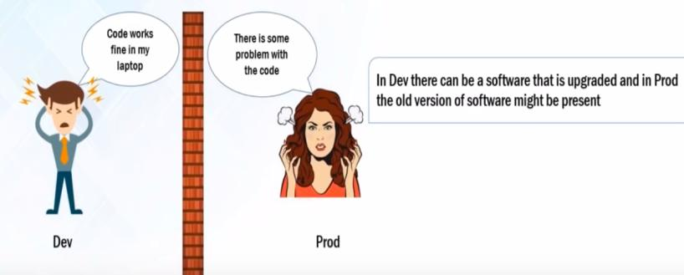
Why We need Docker ?

Slide 7
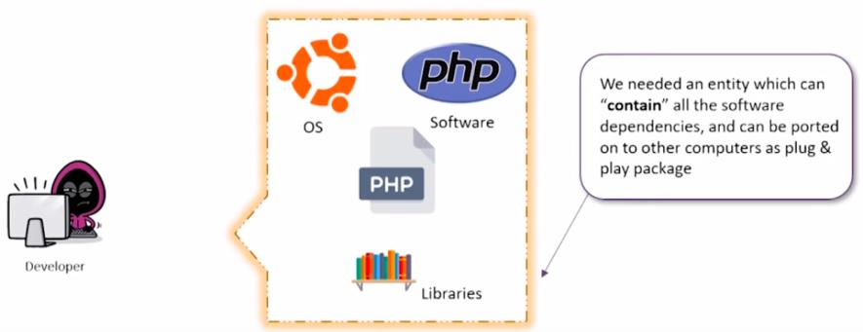
Solution to the Problem ?

Slide 8
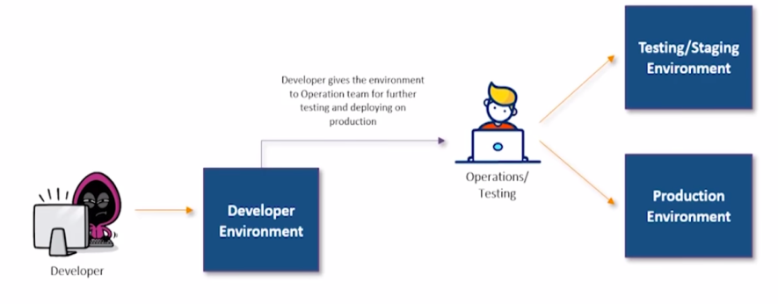
Solution to the Problem ?

Slide 9
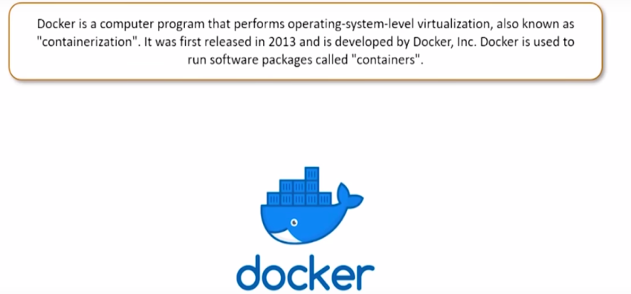
Answer is ?

Slide 10
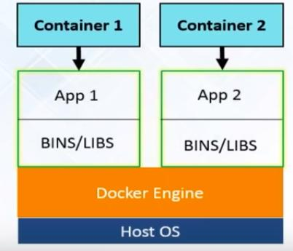
Docker

Slide 11
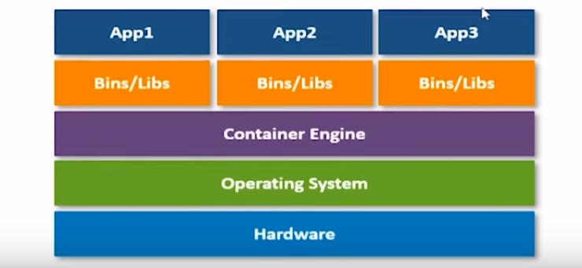
Docker Architecture

Slide 12
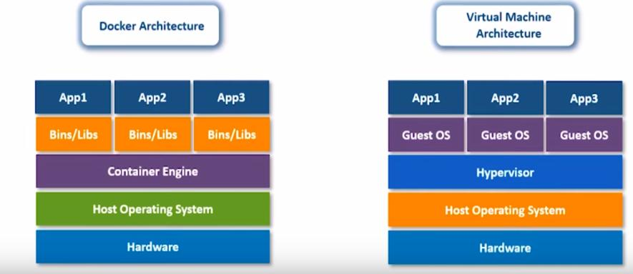
Docker vs Virtual Machine

Slide 13
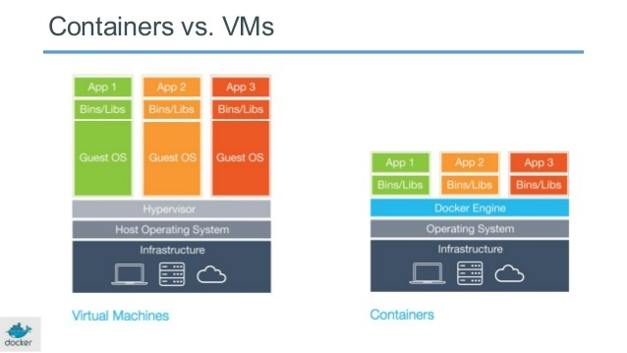
Containers vs VMs

Slide 14
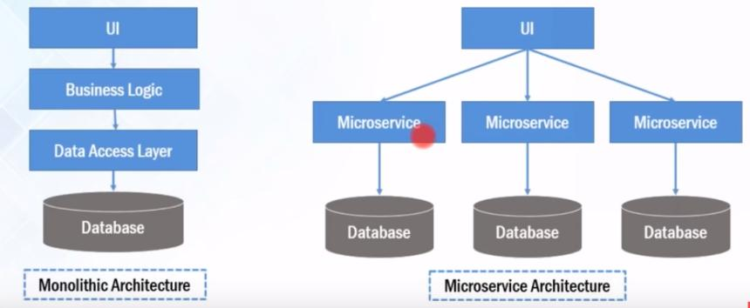
Web application Architecture

Slide 15
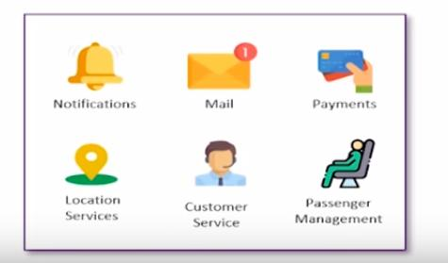
Monolithic Application

Slide 16
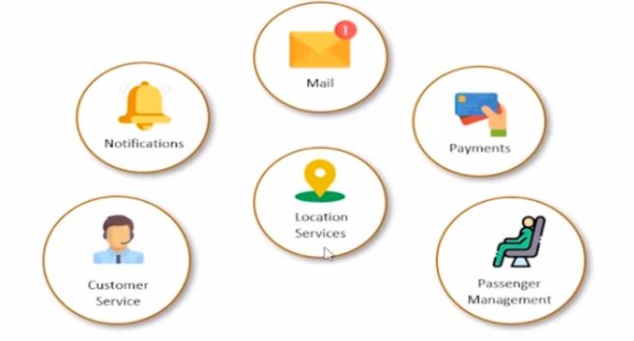
Microservice Architecture

Slide 17
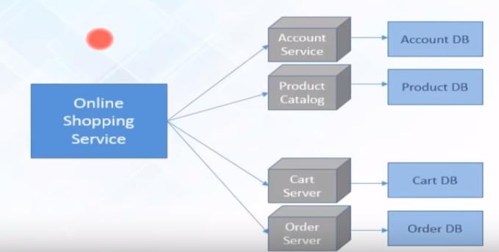
Microservice architecture

Slide 18
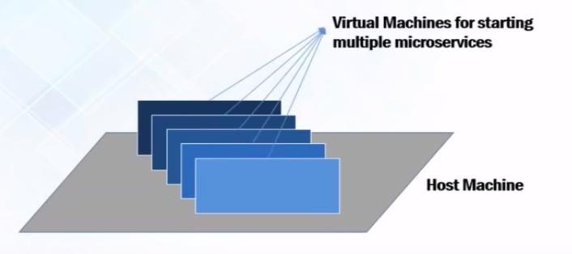
Deploy Microservices

Slide 19
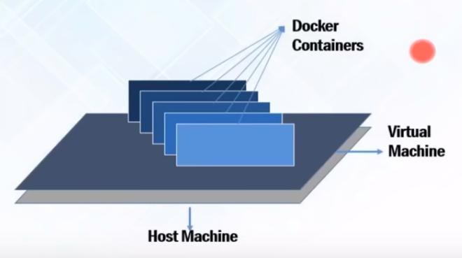
Deploy Microservices using Docker

Slide 20
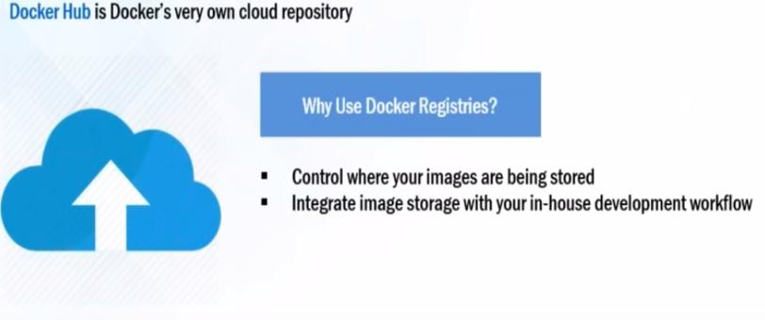
Docker Components

Slide 21
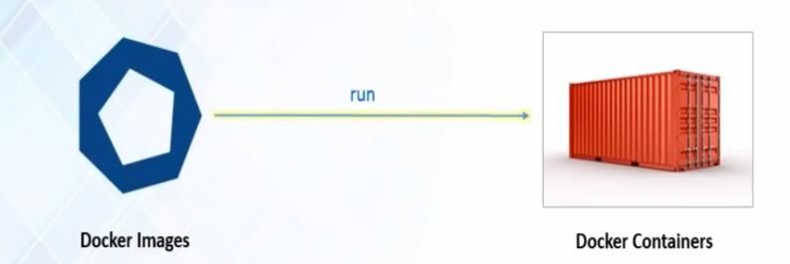
Docker Components

Slide 22
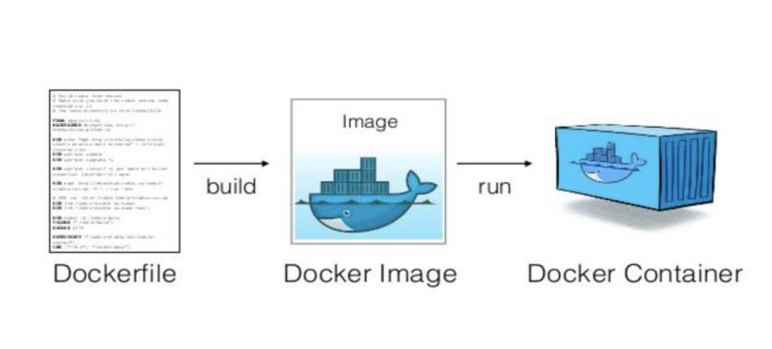
Docker Components

Slide 23
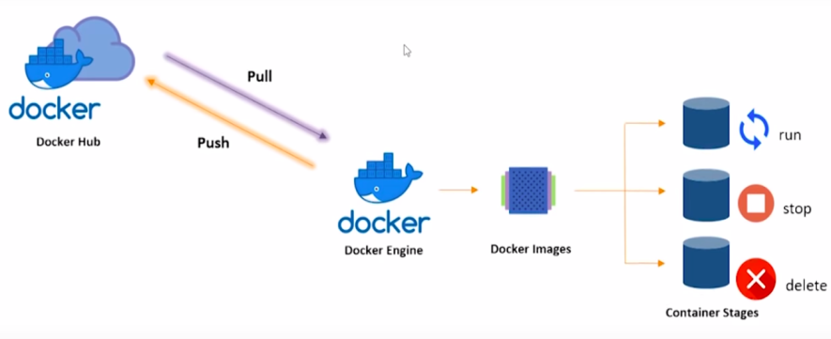
Docker Workflow

Slide 24
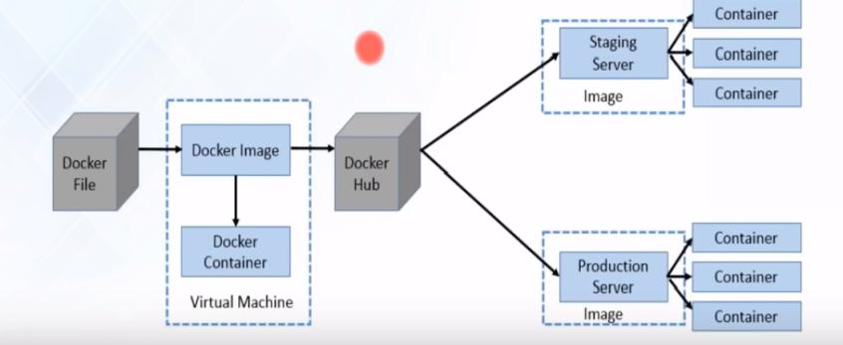
Docker Workflow

Slide 25
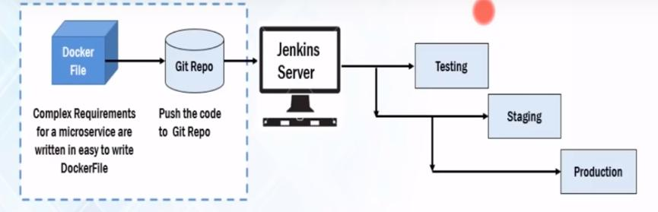
Docker Example

Slide 26
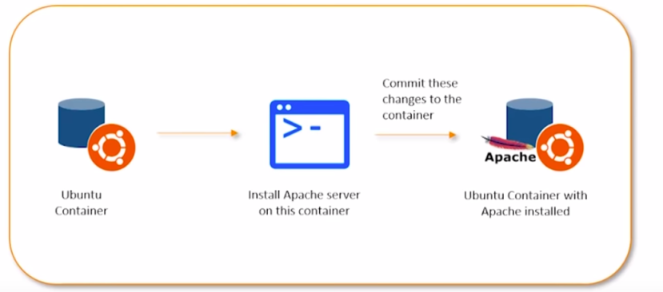
Docker Example

Slide 27
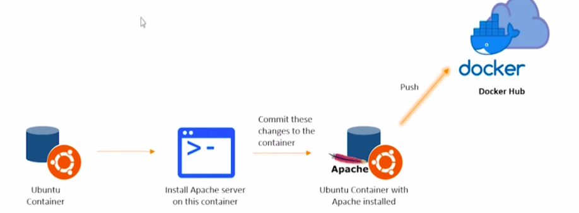
Docker Example

Slide 28
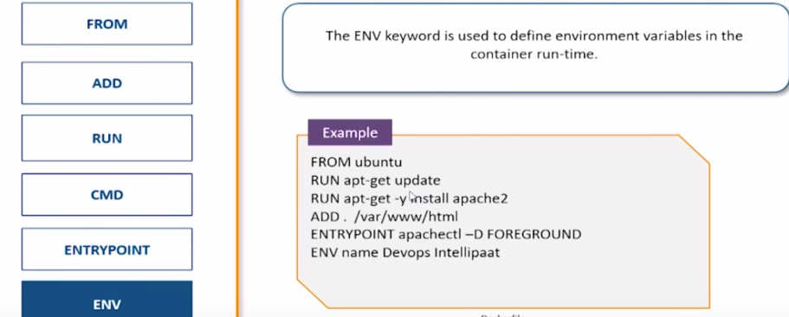
Dockerfile

Slide 29
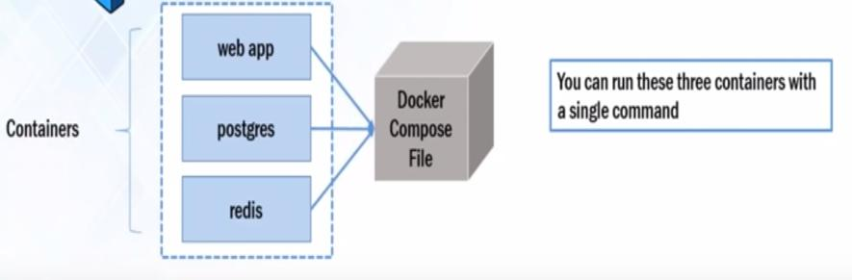
Docker Compose

Slide 30
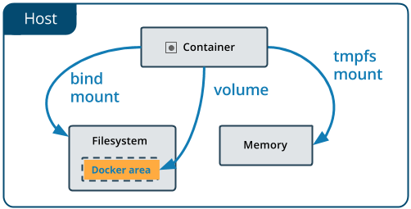
Docker Volumes

Slide 31
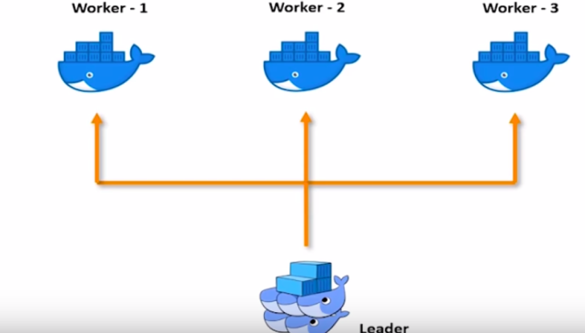
Docker Swarm – Container Orchestration

Slide 32
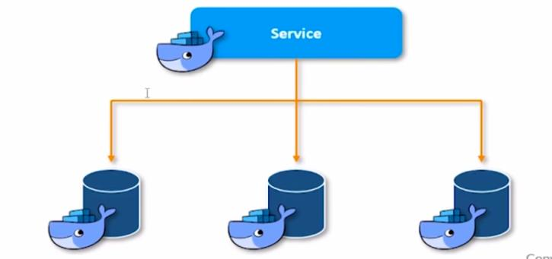
Docker Swarm App Service Deploy

Slide 33
Docker swarm commands
sudo docker swarm init –adervetise-addr=<ipaddr>
sudo docker swarm join with token on workers
sudo docker node ls
sudo docker service create –name apache –replicas 5 –p 82:80 sreedocker123/apache
sudo docker service ls
sudo docker service scale apache=2
sudo docker service rm apache
sudo docker swarm leave
sudo docker swarm leave --force

Slide 34
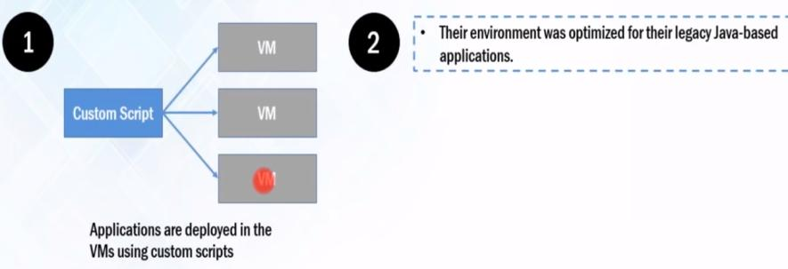
Case study of Docker : Indiana University

Slide 35
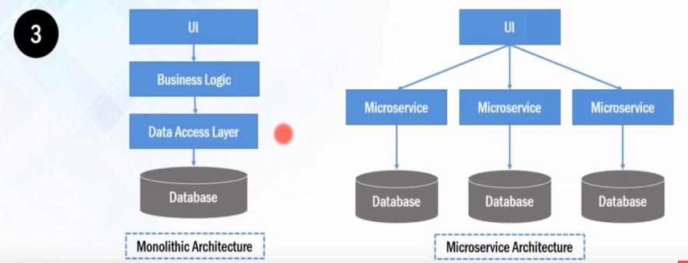
Case study of Docker : Indiana University

Slide 36
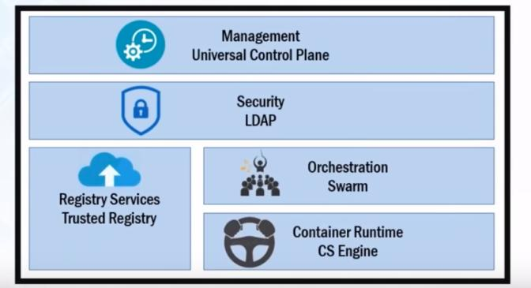
Docker Datacenter

Slide 37
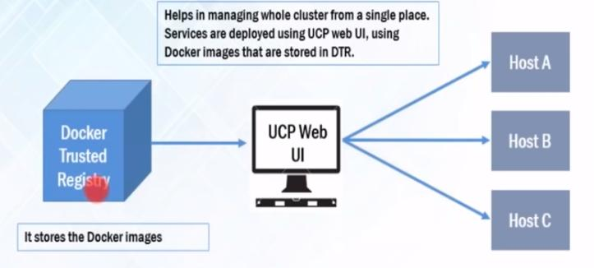
Docker Datacenter

